Slide 1
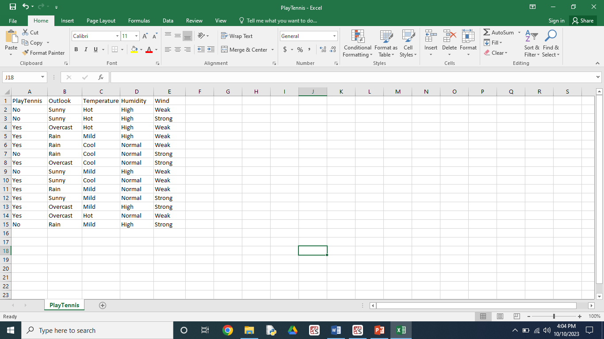

Slide 2
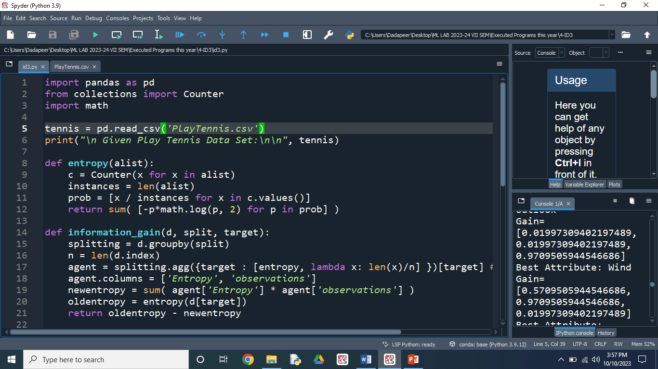

Slide 3
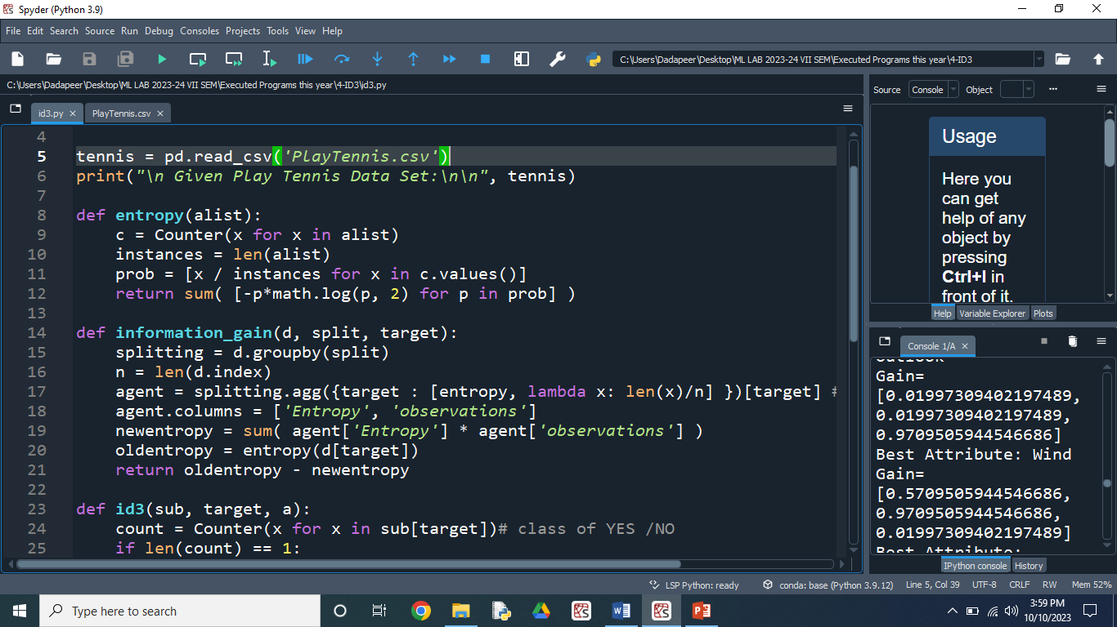

Slide 4
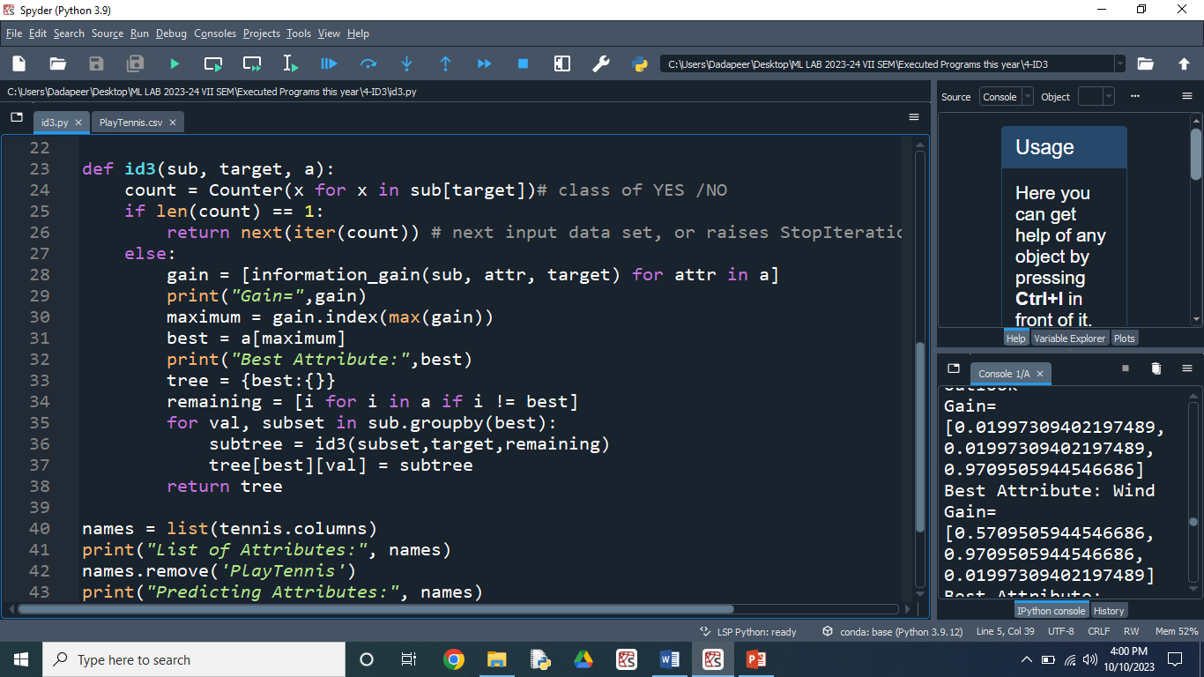

Slide 5
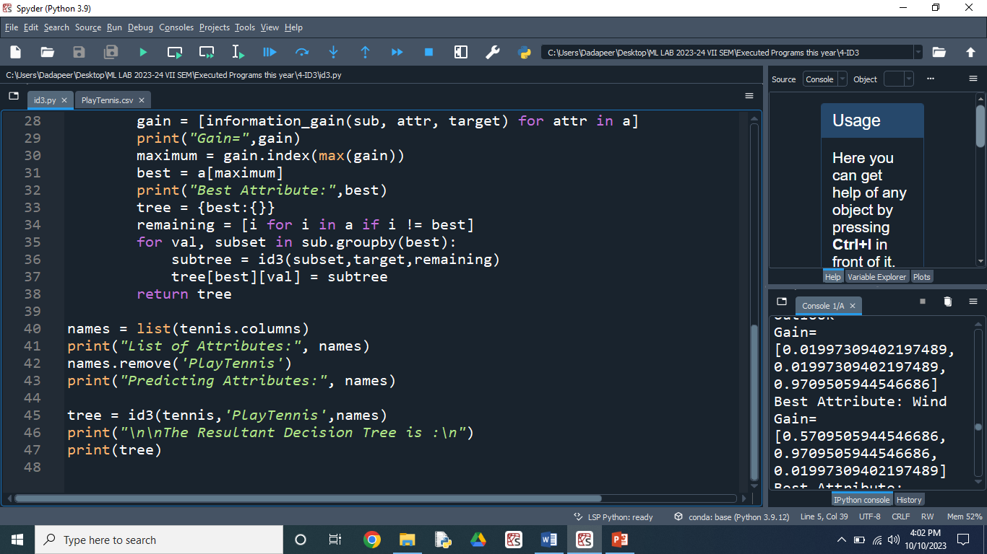

Slide 6
Given Play Tennis Data Set:
PlayTennis Outlook Temperature Humidity Wind
0 No Sunny Hot High Weak
1 No Sunny Hot High Strong
2 Yes Overcast Hot High Weak
3 Yes Rain Mild High Weak
4 Yes Rain Cool Normal Weak
5 No Rain Cool Normal Strong
6 Yes Overcast Cool Normal Strong
7 No Sunny Mild High Weak
8 Yes Sunny Cool Normal Weak
9 Yes Rain Mild Normal Weak
10 Yes Sunny Mild Normal Strong
11 Yes Overcast Mild High Strong
12 Yes Overcast Hot Normal Weak
13 No Rain Mild High Strong

Slide 7
List of Attributes: ['PlayTennis', 'Outlook', 'Temperature', 'Humidity', 'Wind']
Predicting Attributes: ['Outlook', 'Temperature', 'Humidity', 'Wind']
Gain= [0.2467498197744391, 0.029222565658954647, 0.15183550136234136, 0.04812703040826927]
Best Attribute: Outlook
Gain= [0.01997309402197489, 0.01997309402197489, 0.9709505944546686]
Best Attribute: Wind
Gain= [0.5709505944546686, 0.9709505944546686, 0.01997309402197489]
Best Attribute: Humidity
The Resultant Decision Tree is :
{'Outlook': {'Overcast': 'Yes', 'Rain': {'Wind': {'Strong': 'No', 'Weak': 'Yes'}}, 'Sunny': {'Humidity': {'High': 'No', 'Normal': 'Yes'}}}}

